Slide 1
A GEO Opportunity for North America, AMSAT, and Virginia Tech
Virginia Tech, AMSAT-NA team up and using modern SDR builds a capability
Dr Bob McGwier, Director of Research for Hume center at VT and N4HY

Slide 2
DIGITAL TRANSPONDER DESIGN MISSION CONCEPT
Concepts for what follows were originally developed sitting in the basement of Eric Blossom’s basement in Reno by Matt Ettus(N2MJI), Frank Brickle (AB2KT), Eric Blossom (K7GNU), and me (N4HY) when we were holding either the first or second “GnuRadio hackfest” which began very informally when I worked at IDA.
Rideshare ideas were initially proposed by Tom Clark (K3IO) and were called CC Rider.

Slide 3
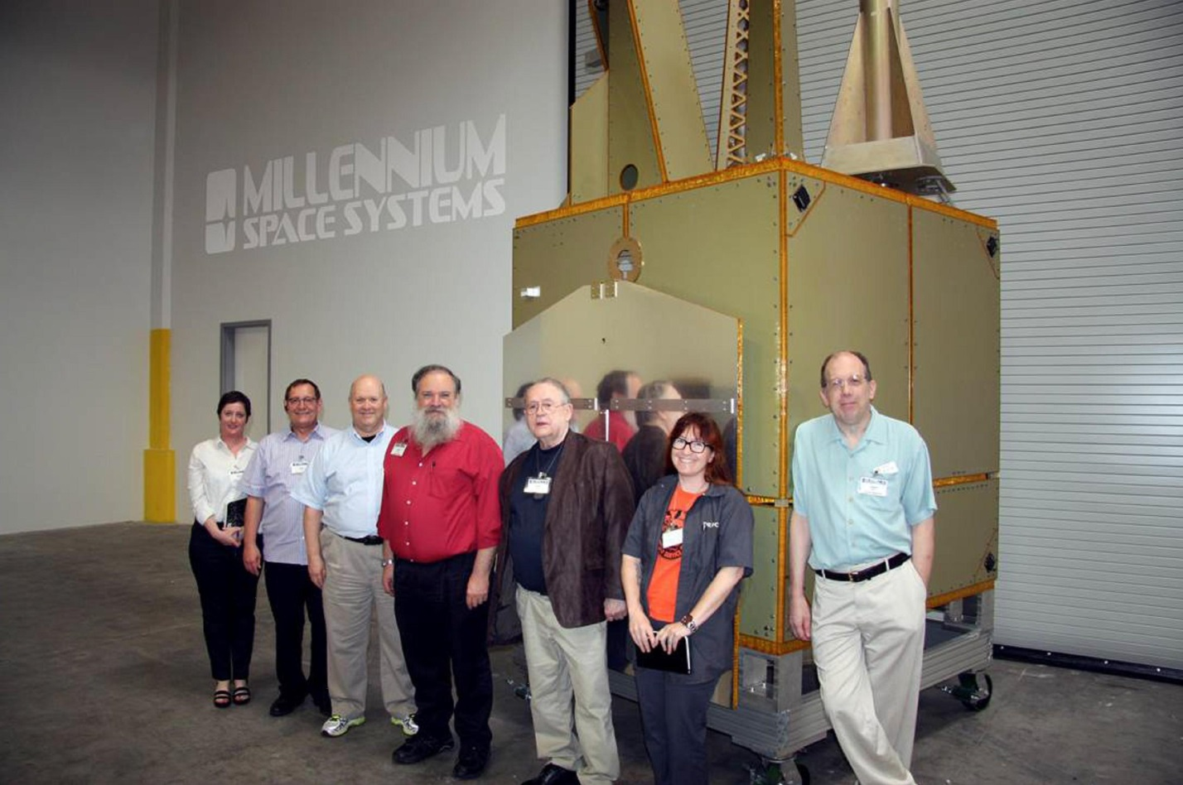
USAF WFOV can host a payload
(L-R) Sonya Rowe, KK4NLO; Jerry Buxton, N0JY; Bob McGwier, N4HY; Franklin Antonio, N6NKF; Tom Clark, K3IO; Michelle Thompson, W5NYV; and Phil Karn, KA9Q

Slide 4
Functional Specs Digital Transponder
Characteristic
Value
Uplink
Downlink
Uplink Physical Layer
Downlink Phy. Layer
Access Method
Downlink parameters
Uplink parameters
5.645-5.655 GHz
10.45-10.46 GHz
FDMA PSK
TDMA PSK
Trunk Mobile like
30+w into phased horns
LNA, phased array

Slide 5
Functional Specs Analog Transponder
Characteristic
Value
Uplink
Downlink
Uplink Physical Layer
Downlink Phy. Layer
Access Method
Downlink parameters
Uplink parameters
5.645+N kHz
10.46 GHz-N kHz
Linear uplink
Linear downlink
FDM
A few watts to a horn
LNA, phased array

Slide 6
WFOV Mission Overview
Geosynchronous orbit with an inclination between 4 and 8 degrees
Subsat longitude will vary as the test period and then mission period unfolds
The spacecraft will spend most of its time in full view of all of CONUS
There will be infrequent times when WFOV will have NO view of CONUS
Mission is up to a decade long depends on actions but initial funded plan is three years
This should be long enough to be a major player in EMCOM

Slide 7
Tentative X-Band TX Downlink Plans
X-Band power amplifier will probably be four GaN “bricks”, each producing 8-10 W @ ~50% efficiency.
Probable GaN transistor suppliers Cree or Qurovo.
Each “brick” will feed a horn with ~20⁰ beam. Each of the 4 horns will have some phase control to move the beam over ~20⁰.
Multiple amplifiers will allow redundancy in case of a failure.
Design work is in the capable hands of Marc Franco, N2UO.
X-band “bricks” will also be used on other AMSAT missions, including Lunar CubeQuest . . . .

Slide 8
Gr0und Terminal
Charateristic
Value
Low size weight and power
Antenna gain
Looks like E310 on steroids with a real antenna and LNA
Operated by small battery when possible but generated power when required
Likely two small dishes
Dual band feed is very hard to get isolation

Slide 9
Tentative X-Band Minimal RX Plans
Make heavy use of unmodified COTS TVRO hardware
0.6 – 1.0 M “DirectTV” Dish
“New Generation” TVRO LNB with with linear feeds and xtal-controlled LO @ 9750 MHz, producing RX IF around 700 MHz.
700 MHz IF feeds SDR using GNU Radio software
SDR prototypes use COTS Ettus and/or HackRF hardware.
Major efforts in San Diego (Michele Thompson,W5NYV et al) and @VA Tech (Zach Leffke, KJ4QLP & Tom Clark , K3IO).
Hi-Accuracy Ref Freq: 10 MHz comb from GPSDO radiated into feed.
Same SDR will also generate 5.6 GHz uplink.

Slide 10
FDMA Digital Uplink
Number of uplink channels will be limited by the required SNR on the uplink and downlink and determined by a detailed analysis
Assume for now narrow PSK uplink carrying data: vocoder, picture, email, …
The receiver structure for the FDMA signal is based on polyphase filterbank channelizer (perfect reconstruction)
Basic tenets of trunk mobile radio with security, verification, and authorization to access when appropriate

Slide 11
FDM Analog Transponder
Bandwidth will be limited by the required SNR on the uplink and downlink and determined by a detailed analysis (shared power, antennas, etc)
Assume for now ~ten SSB signals
The transceiver structure for the FDM signal is bent pipe linear but with super channelized Leila and other advanced effects implemented digitally
Just exactly like AO-10, AO-13, AO-40 but better

Slide 12
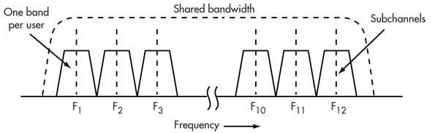
Channelized digital radio is FDMA

Slide 13
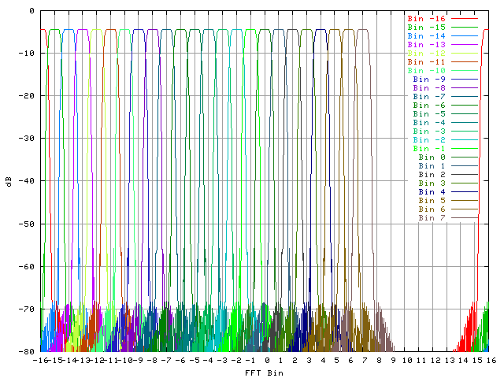
Receiver Structure is Channelized Input

Slide 14
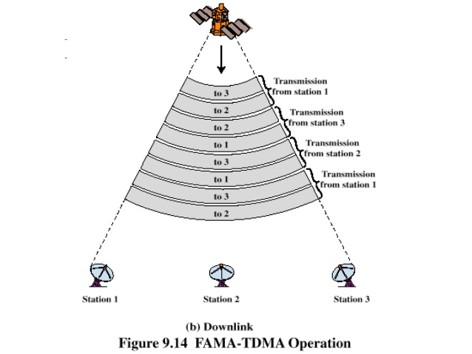
TDMA DOWNLINK

Slide 15
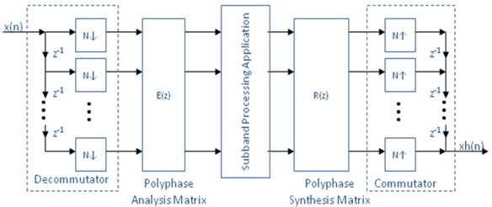
“Entire” Digital Transponder Notionally

Slide 16
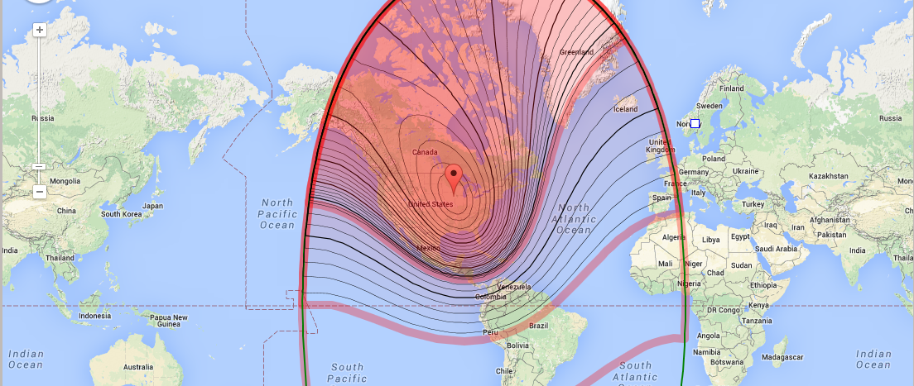
Possible Satellite Footprint 74 W

Slide 17
USAF WFOV
Colonel Fred Kennedy, USAF is Air Force lead on the Wide Field of View mission
K8KA, Jeff Ward formerly with UOSAT and SSTL, TAPR and AMSAT long time contributor is now VP Products at Millennium
Millenium is integrator for WFOV
Col Kennedy is not a ham but is a former student of Jeff Ward at Univ of Surrey.

Slide 18
Millennium Space Systems
Small company (100-ish employees) in El Segundo with Stan Dubyn as Chairman and CEO
Stan formerly ran SpaceDev which built ChipSat
Jan King, W3GEY former VP Engineering AMSAT worked for Dubyn at SpaceDev
Bob Davis, KF4KSS,former Asst VP Engineer AMSAT worked for Dubyn at SpaceDev
Opening picture taken at MSS

Slide 19
RINCON Research
RINCON Research is a super corporation in Tucson, Az that does serious work for USG.
They have a professional software defined radio they are going to donate that will run our mission on WFOV
Mike Parker is founder and KT7D. Early member of TAPR with Tom Clark, K3IO and me AND Mike got most of his top early folks from TAPR
Rincon has donated their LPFE (similar to USRP E310)
On the internet via VPN for VT and those we admit to program and learn to use
Rincon will also donate SDR for Phase 3E

Slide 20
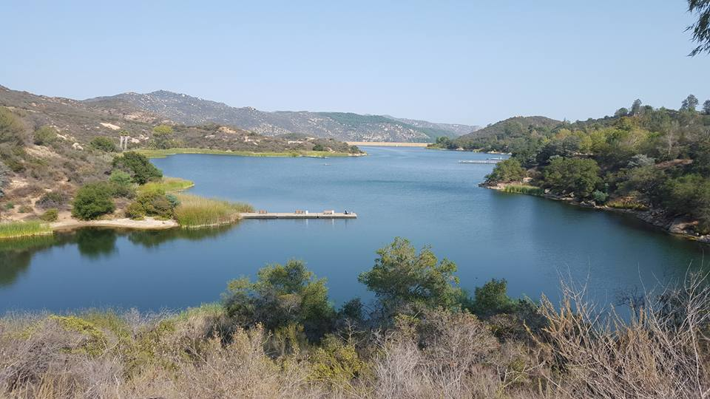
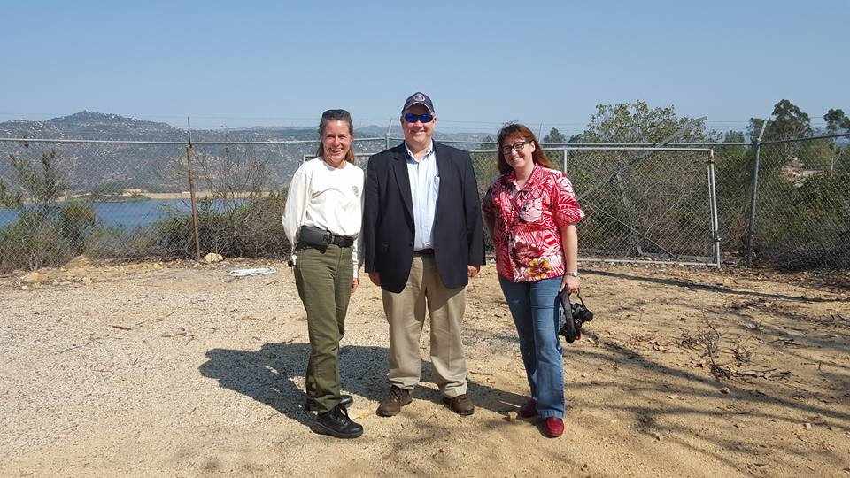
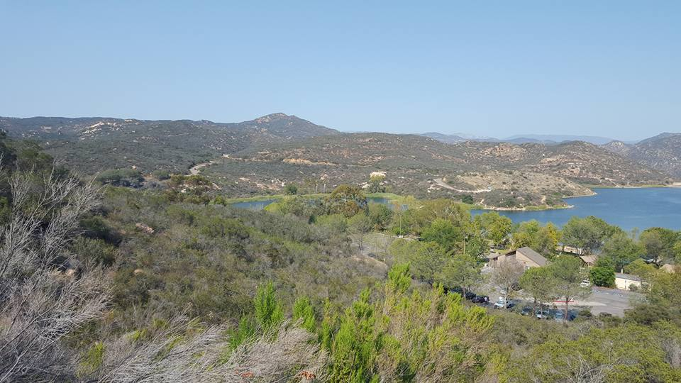
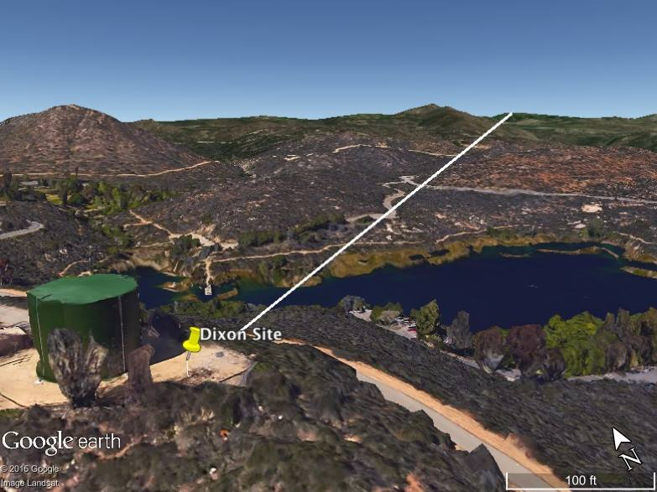
Experiments under Way in SoCal
Dixon Lake, Escondido
KA6OYD, N4HY, & W5NYV
Palomar Ridge

Slide 21
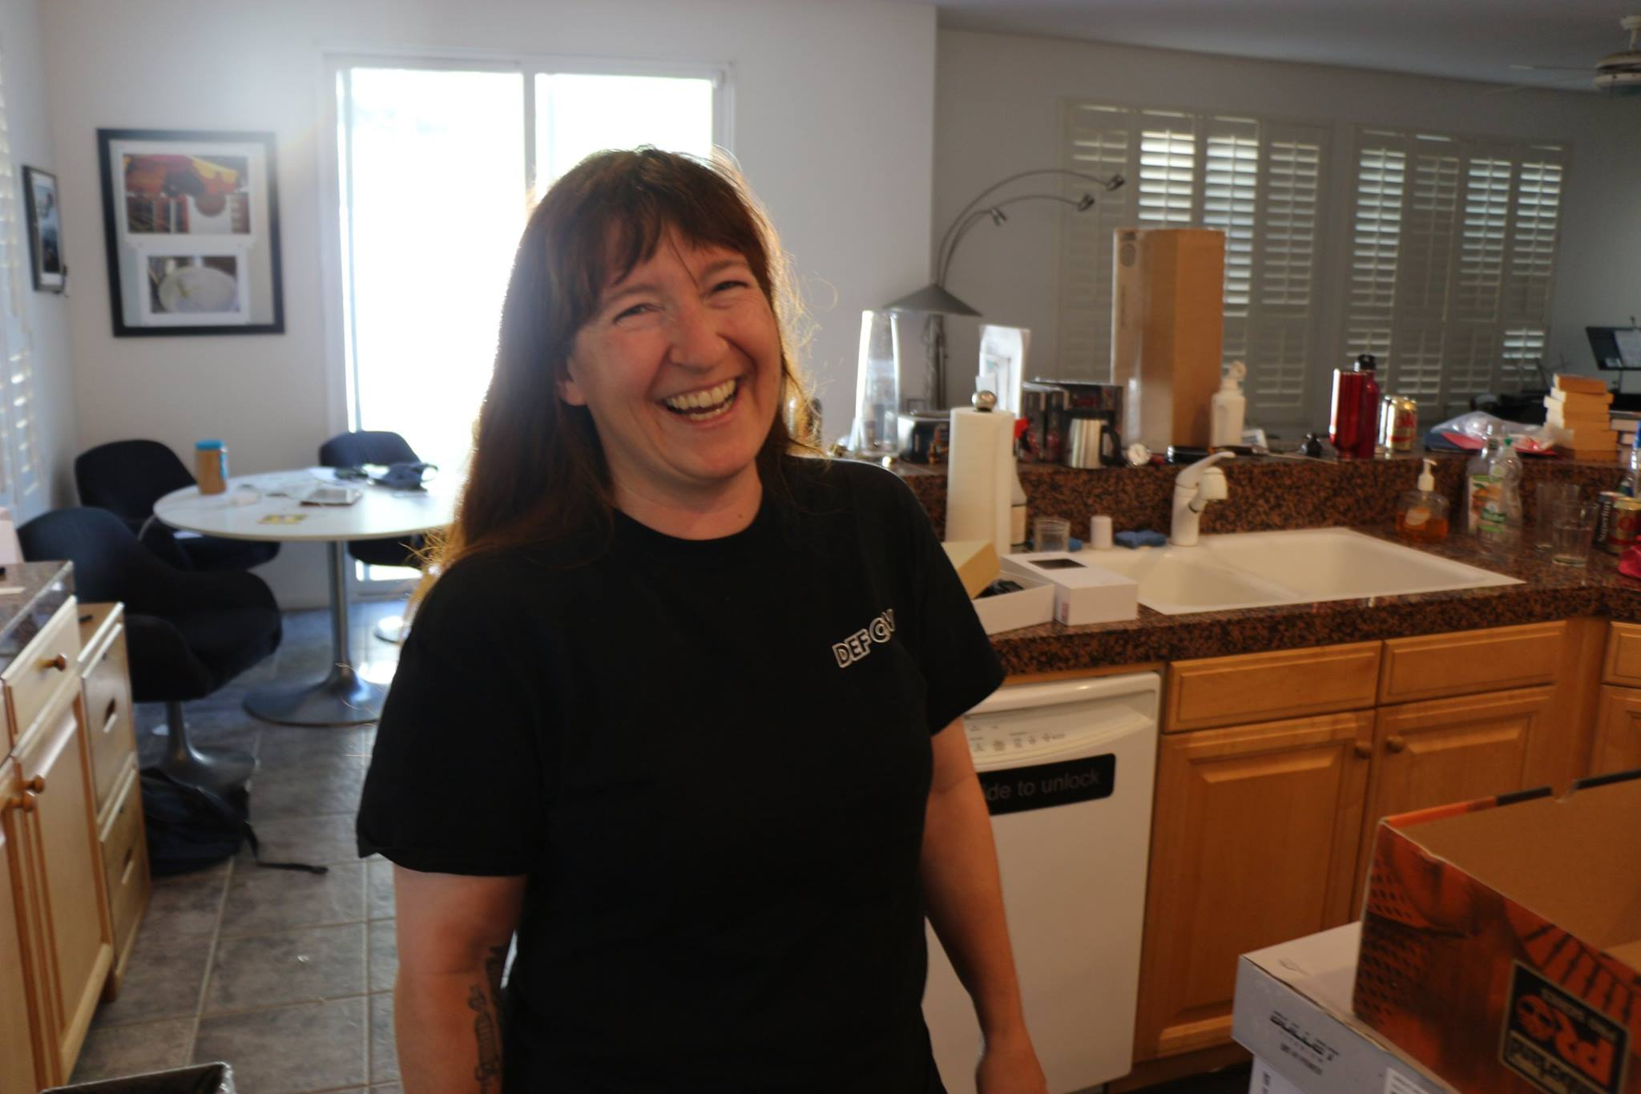
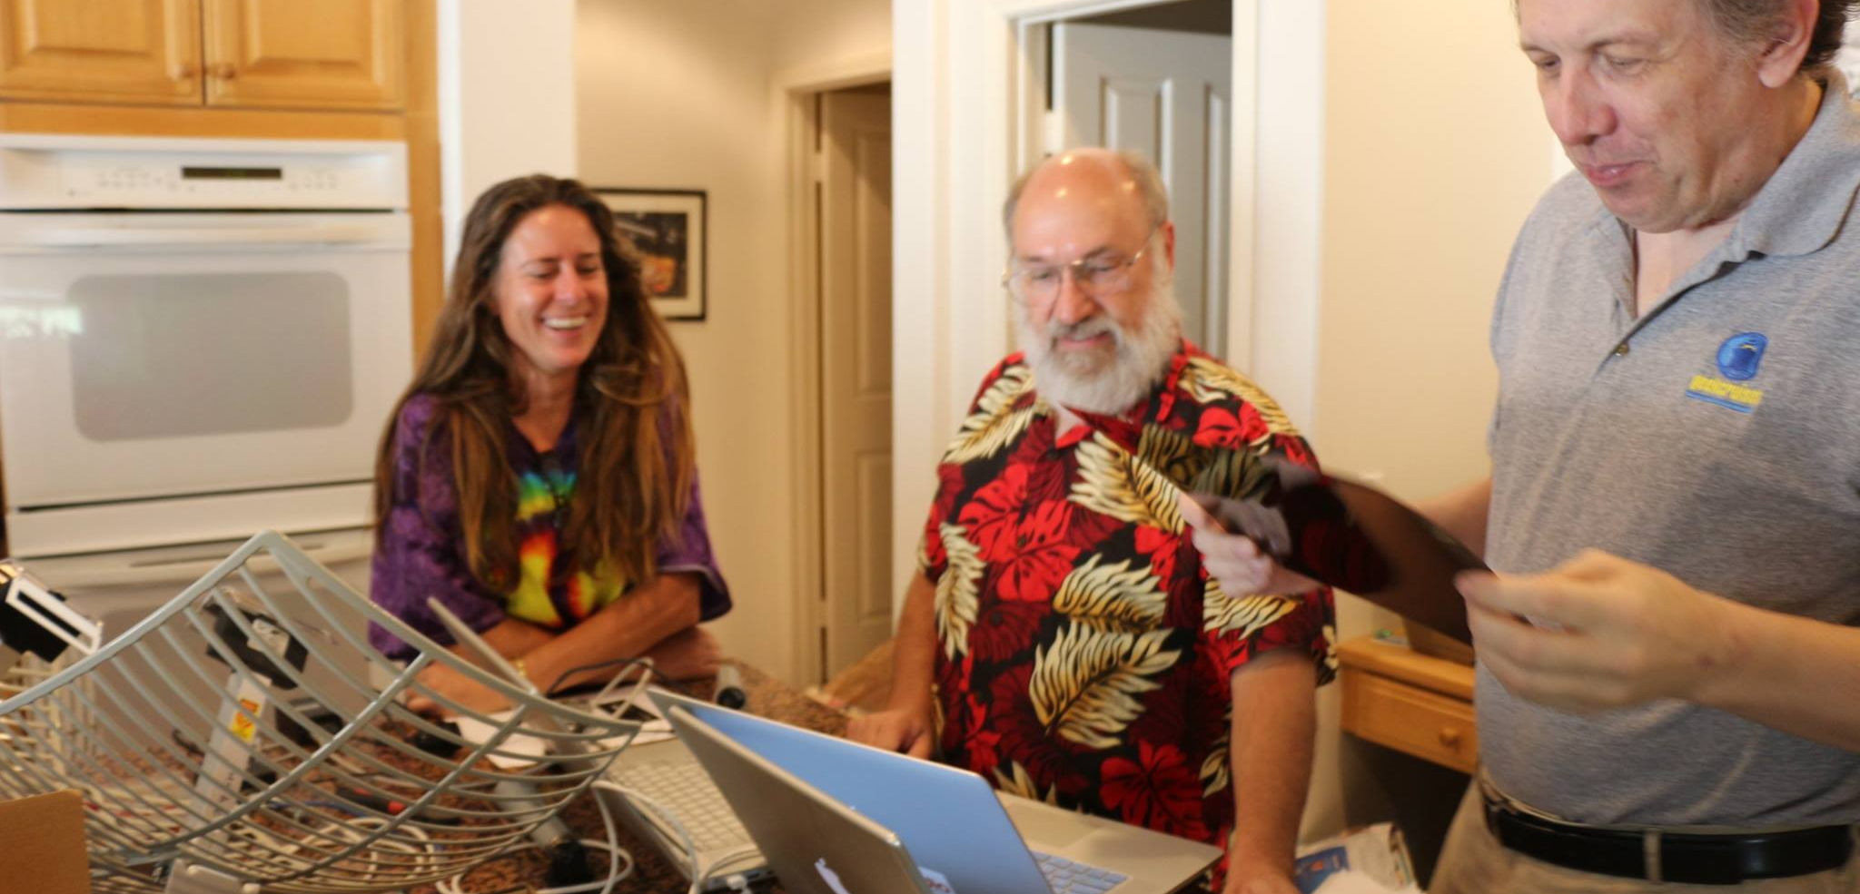
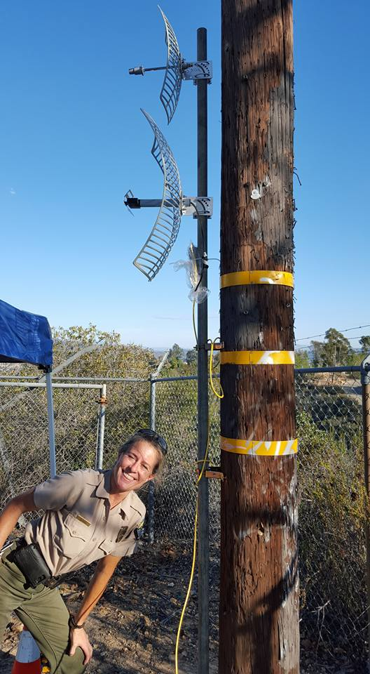
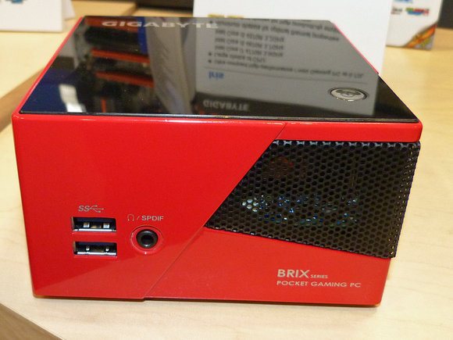
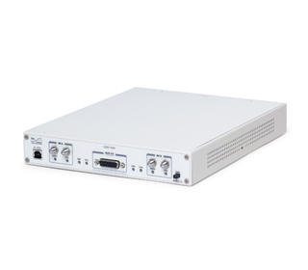

Slide 22
Ettus Research and SoCal Experiments
Ettus Research is donating USRP equipment with GPSDO for the Dixon Lake <-> Palomar ARC experiments
Hume Center students have built a GnuRadio demo of the transponder system and are giving talks tomorrow and doing a demo in McKinley Room (come on down see us y’all, ya heah)

Slide 23
THANK YOU
USAF
ARRL
AMSAT
Millennium
Palomar Amateur Radio Club
Ettus Research
Escondido, CA Parks and Recreation
Hume Center for National Security and Technology
And all of Virginia Tech, for Giving me a place to thrive
FEMA
May be premature, but I don’t think so

